Slide 1
WWIII,the Middle East, Israel, and Hamas, and the Eclipse of 2024 in Bible Prophecy
Mountain View Christian Church

Slide 2
Fiction is sadder than truth
Exodus 4:8 and the great eclipse
Exodus 4:8 (ESV)
8 “If they will not believe you,” God said, “or listen to the first sign, they may believe the latter sign.”
Since nothing seemed to happen at the first sign, look for the next one!

Slide 3
Main points
The Good News: Hamas, Israel, the Middle East have no prophetic significance.
The bad news: wars will continue for a very long time
More bad news: we are in a trough of rebellion.
Good News again: Christ rules now, and this will never end.

Slide 5
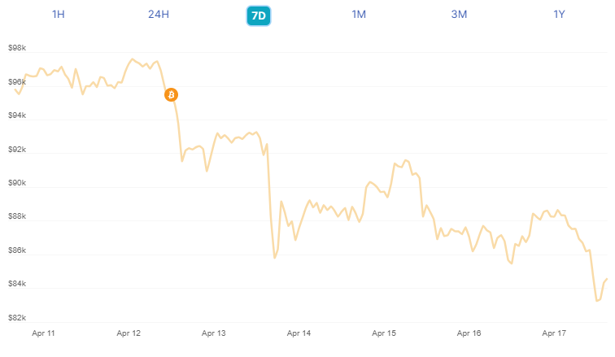
The dangers of short-term thinking. Does this look like a good investment?

Slide 6
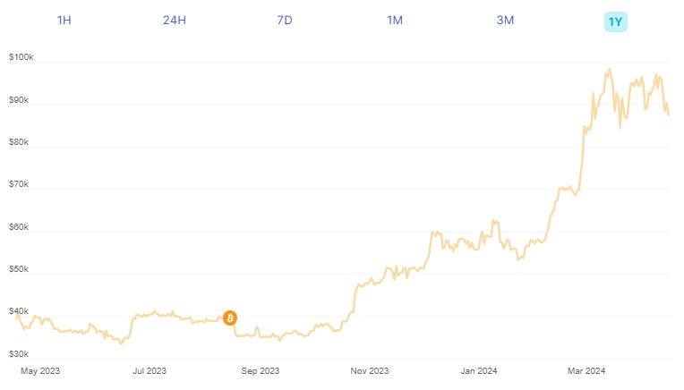
How about this?

Slide 7
Point
Think long term, not short term.
Think of your great-great grandchildren and beyond.
Christ is Lord of time and history
Eschatology is never dependent upon your circumstances, but your eschatology will influence your circumstances: optimism or pessimism.
You will physically die before Christ returns.

Slide 8
Revisit Matthew 23 and 24.
Christ’s Word is 100% certain and fulfilled.
We live in the time of great promises:
Isaiah 11 Matthew 16:18
Matthew 28:20

Slide 9
Fulfilled? Yes!
Matthew 23:36 Truly, I say to you, all these things will come upon this generation.
Matthew 24:34 Truly, I say to you, this generation will not pass away until all these things take place.
Mark 13:30 Truly, I say to you, this generation will not pass away until all these things take place.
Luke 21:32 Truly, I say to you, this generation will not pass away until all has taken place.
Acts 2:40 And with many other words he bore witness and continued to exhort them, saying, “Save yourselves from this crooked generation.”
Philippians 2:15 that you may be blameless and innocent, children of God without blemish in the midst of a crooked and twisted generation, among whom you shine as lights in the world,

Slide 10
Γενεά (genea), not Γένος (genos) (generation, not race)
A generation is about 40 years.
33 AD to 70 AD ≈ 40 years.
Jesus predicted it, it happened.
The source of our confusion: “genos” in these passages:
“generation” or “kind” or “family”
Mark 9:29 kind
Acts 7:13 family
Acts 7:19 race
Acts 17:28 offspring
Acts 17:29 offspring
1 Peter 2:9 race
Revelation 22:16 descendant

Slide 11
1 Peter 2:9 & the use of “generation”
KJV
ESV
⁹ But ye are a chosen generation, a royal priesthood, an holy nation, a peculiar people; that ye should shew forth the praises of him who hath called you out of darkness into his marvellous light:
⁹ But you are a chosen race, a royal priesthood, a holy nation, a people for his own possession, that you may proclaim the excellencies of him who called you out of darkness into his marvelous light.

Slide 12
Uses of the word determine the meanings
Genos means “race” or “kind” in 1 Peter 2:9. KJV translates it as “generation,” but ESV says “race.”
The assumption by many in Matthew 23 and 24 is that a generation is genos, and so means “a kind, or a family, or a people.” Therefore, what Jesus was saying was, “this generation (the Jews) will not pass away until this is fulfilled.” (Matthew 23:36; 24:34). This means that everything in Matthew 24 is in our future, rather than in Jesus’ hearers future!
But what Jesus was saying was, “This generation” (those living now, within the 40 years) will not pass away.
Jesus’ Words were completely fulfilled.
Modern-day prophecy “experts” refuse to acknowledge this fact.

Slide 13
The conundrum
If Jesus actually meant “this generation” as those actually living at that time, how was Matthew 24 fulfilled?
Because His words are misunderstood, there are two options
They didn’t come true because He was wrong.
He was right, but was talking about a distant future.
Or, another option: Jesus Words were fulfilled, even Matthew 24:29-31!

Slide 14
Matthew 24:29–31 (ESV)
29 “Immediately after the tribulation of those days the sun will be darkened, and the moon will not give its light, and the stars will fall from heaven, and the powers of the heavens will be shaken. 30 Then will appear in heaven the sign of the Son of Man, and then all the tribes of the earth will mourn, and they will see the Son of Man coming on the clouds of heaven with power and great glory. 31 And he will send out his angels with a loud trumpet call, and they will gather his elect from the four winds, from one end of heaven to the other.

Slide 15
Compare to:
Genesis 37:5-11
Isaiah 13:9-10
Acts 2:16-21 (Joel 2:30-32)

